Slide 1

Banking System
INFO 5100: Application Engineering Development
Final Project
-Sumeet Usturge
001676003

Slide 2









Request reply
Cyber team keeping
close watch
Work request taken by one of employee
Request to open A/C
If not sure,
escalate to teir-2 team
Request receive
by Bank
Inform manager
Request reply

Slide 3
OBJECT MODEL-EcoSystem
Business
Configuration System
Organization Directory
Network
Organization Directory
Organization Directory
Multiple Networks
Organization Directory
Enterprise
Organization Directory
Organization Directory
Multiple Enterprises
Manager Organization
Organization Directory
Organization Directory
Organization Directory
Organization Directory
Bank Employee Organization
Organization
Core Banking Organization
Organization Directory
Organization Directory
Organization Directory
Organization Directory
Organization Directory
Organization Directory
Employee Directory
User Account Directory
Work Queue
Cyber Security Organization
Employee
User Account
Work Request
Roles
Customer Work Request
Core Banking Work Request
Manager Role
Bank Employee Role
Core Banking Team Role
Cyber Security Role
Customer Role

Slide 4
Use Cases
System Admin to add Network, Enterprise.
System Admin to add Enterprise Head.
Enterprise Head to add organizations i.e. Bank Employee Organization, Core Banking Team Organization, Cyber Security Organization.
Enterprise Head to add Employee to each organizations.
Enterprise Head to assign login credentials to employees.
Bank Employee can validate the new user request for account opening.

Slide 5
Use Cases Cont..
Bank Employee can escalate validation issue to core banking team.
Core Banking team can view the document and validate the request from bank employee.
Core Banking team can pass/fail the new user request.
Cyber security keeps the login hours of each employee in the organization.
Cyber security to show the log details in pictorial form.
New User can send request to bank for account opening.

Slide 6
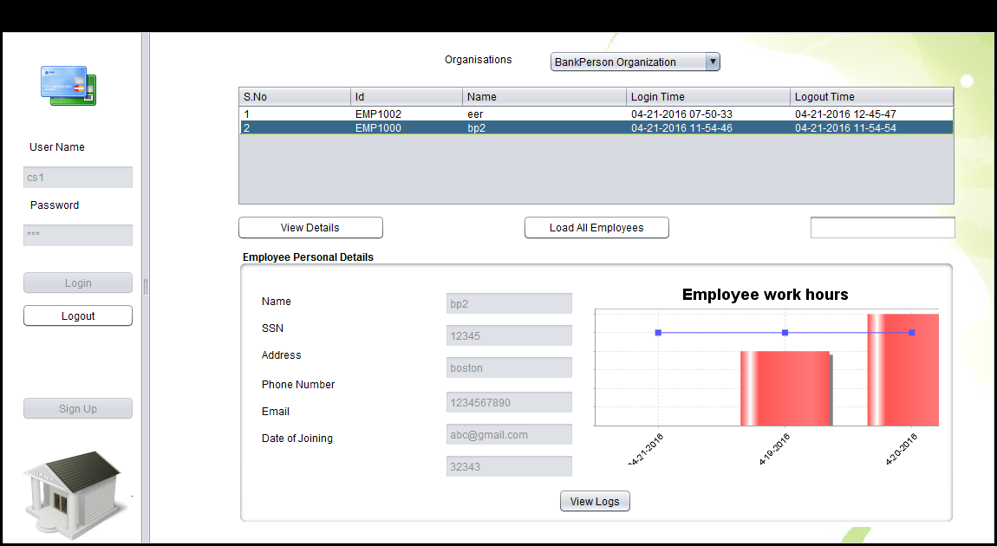
Cyber Security JPanel

Slide 7
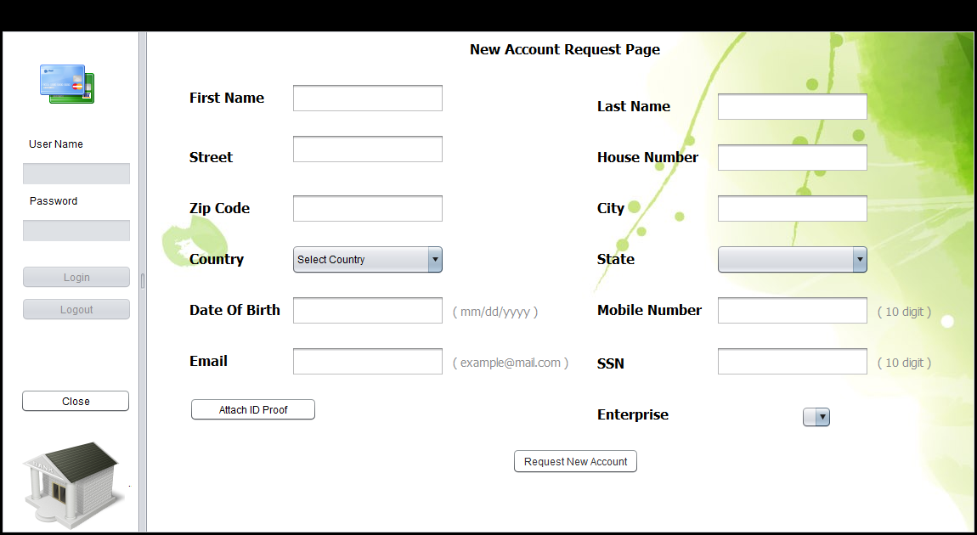
New Account Request JPanel

Slide 8
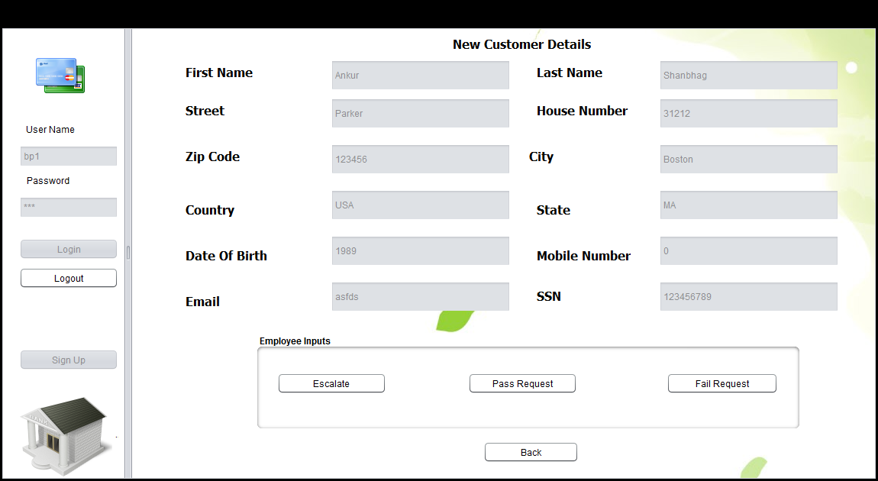
Bank Employee JPanel

Slide 9
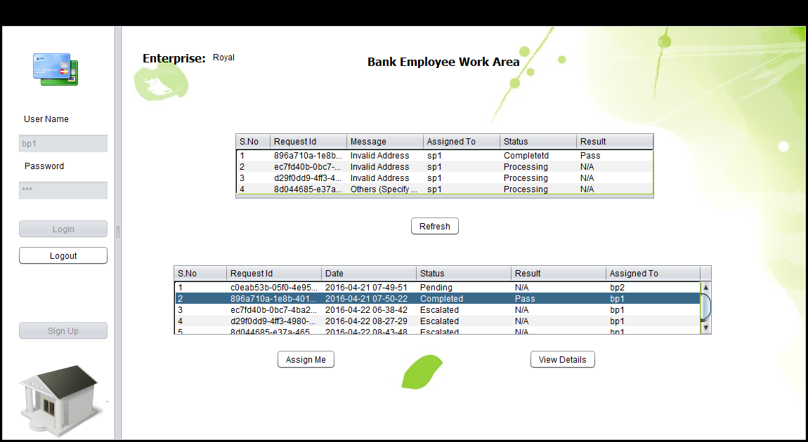
Bank Employee WorkArea

